Slide 1
Monitoring trees outside the forest
John Brandt
World Resources Institute

Slide 2
Issues in monitoring trees outside forest
Low resolution of imagery
High background variability and noise
Small object size
Sub 10m shifts in georeferencing
Traditional ML approaches on GEE are not expressive enough (RF)
Out of box computer vision approaches do not work because of small image size, variability of data, and variability of segmentation maps

Slide 3
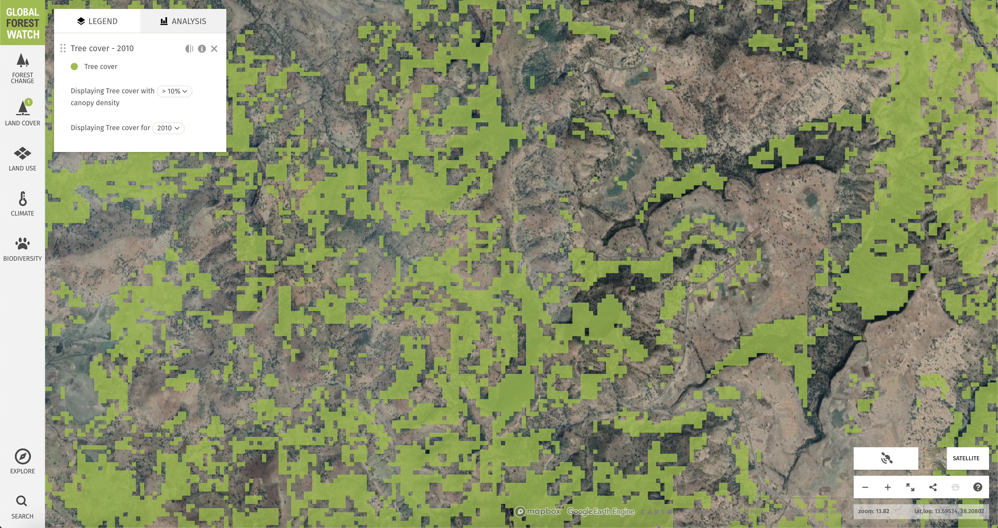
Scattered trees have variable backgrounds
Trees look like crops
Trees look like grass

Slide 4
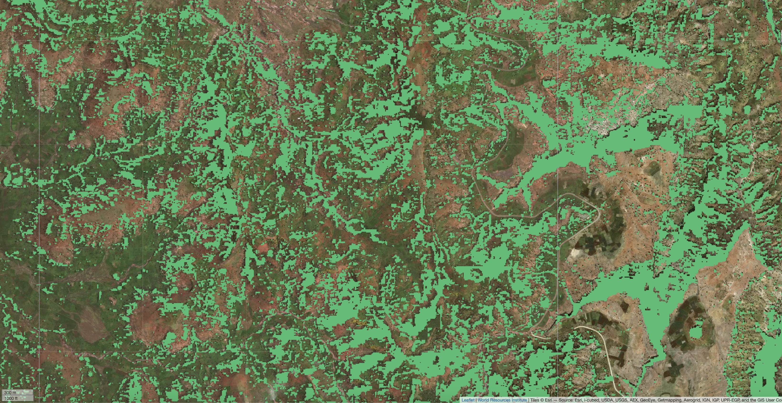

Slide 5
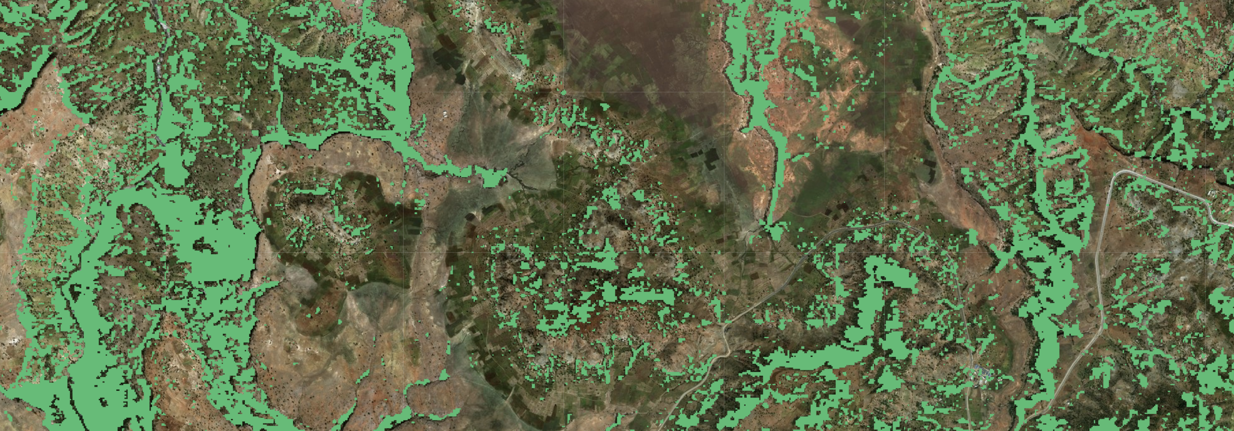

Slide 6
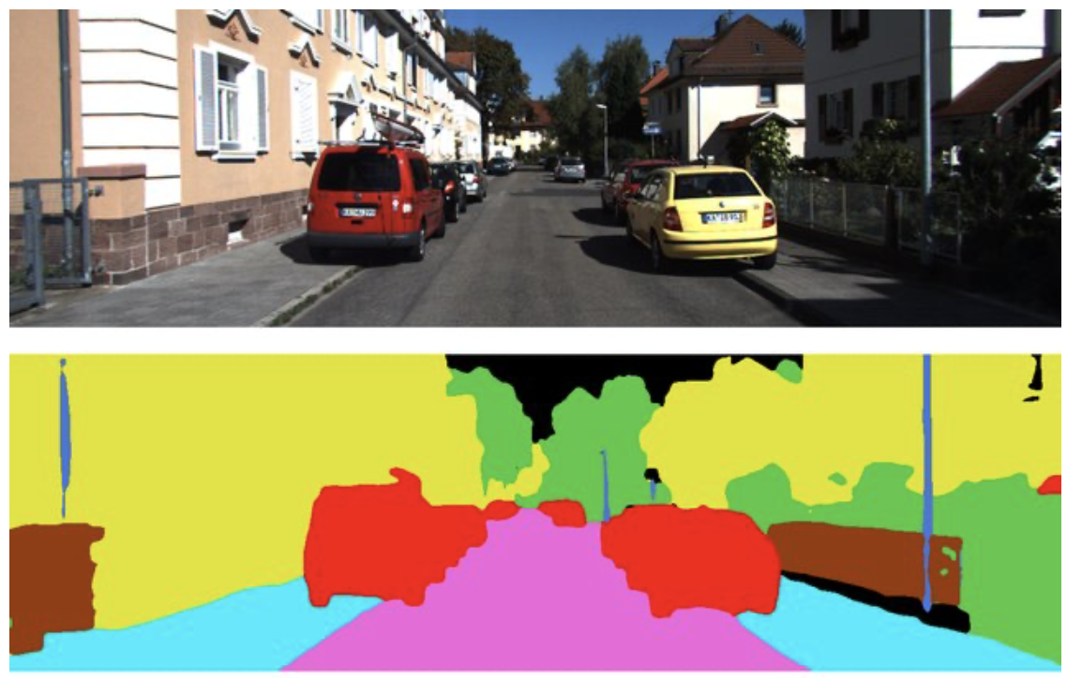
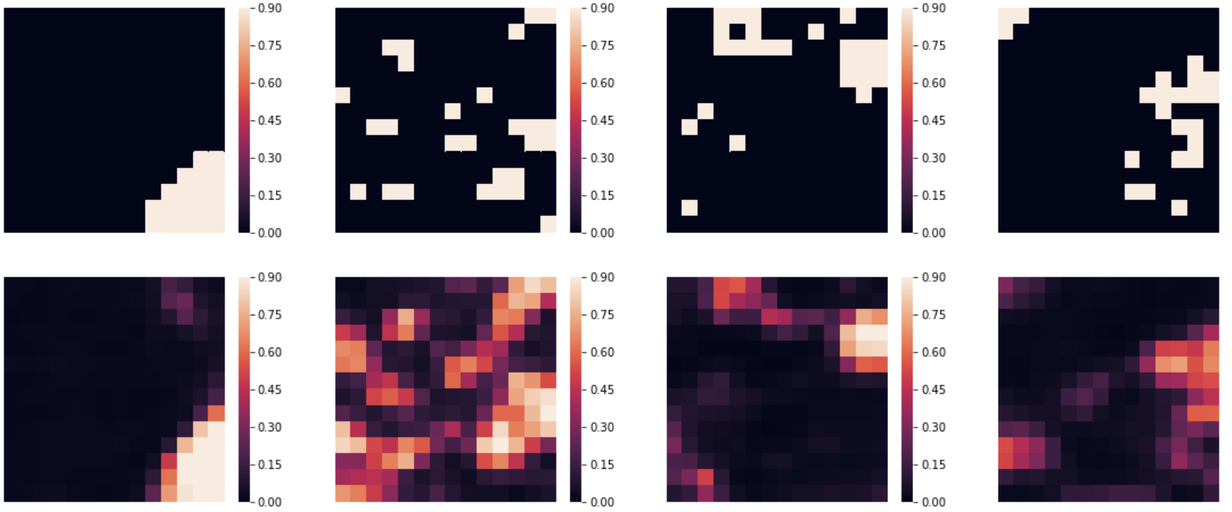
Why out-of-box algorithms fail
1 million + pixels
Shapes consistent
Regions consistent
Colors consistent
196 pixels
No shape, region, or color consistency
Each output is distinct

Slide 7
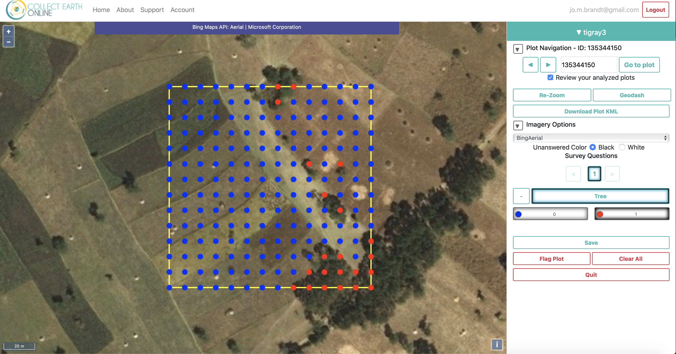
Data
700 2 hectare plots
Randomly sampled across Tigray, Ethiopia

Slide 8
Georeference correction
Receptive field: 140x140m
Input scene: 160x160m
Tiled input: 180x180m
Modeled with EM

Slide 9
Georeference correction
Receptive field: 140x140m
Input scene: 160x160m
Tiled input: 180x180m
[0. , 0. , 0.21, 0.12, 0. , 0.37, 0.15, 0.13, 0. ]
Sub 10m shifts in georeferencing

Slide 10
Time aggregation
Biweekly mean composites of 10 and 20m bands, selecting the two images per month with the lowest cloud cover
Cap on cloud cover of 20%, bilinearly interpolate if missing imagery
Fuse S2 data with percent slope calculated from DEM
Normalize all data to [0, 1] range
High background variability and noise: Temporal data encompasses differences between foreground and background

Slide 11
Model
Fully convolutional network with:
Convolutional LSTM encoder with layer normalization
Feature pyramid attention between encoder and decoder
Concurrent spatial and channel squeeze excitation decoder
AdaBound optimizer
Focal loss for a warm-up, fine tuned with Lovasz softmax. Focal loss is tuned (gamma and alpha) for each image.
Equibatch sampling, visiting every C clusters each N samples

Slide 12
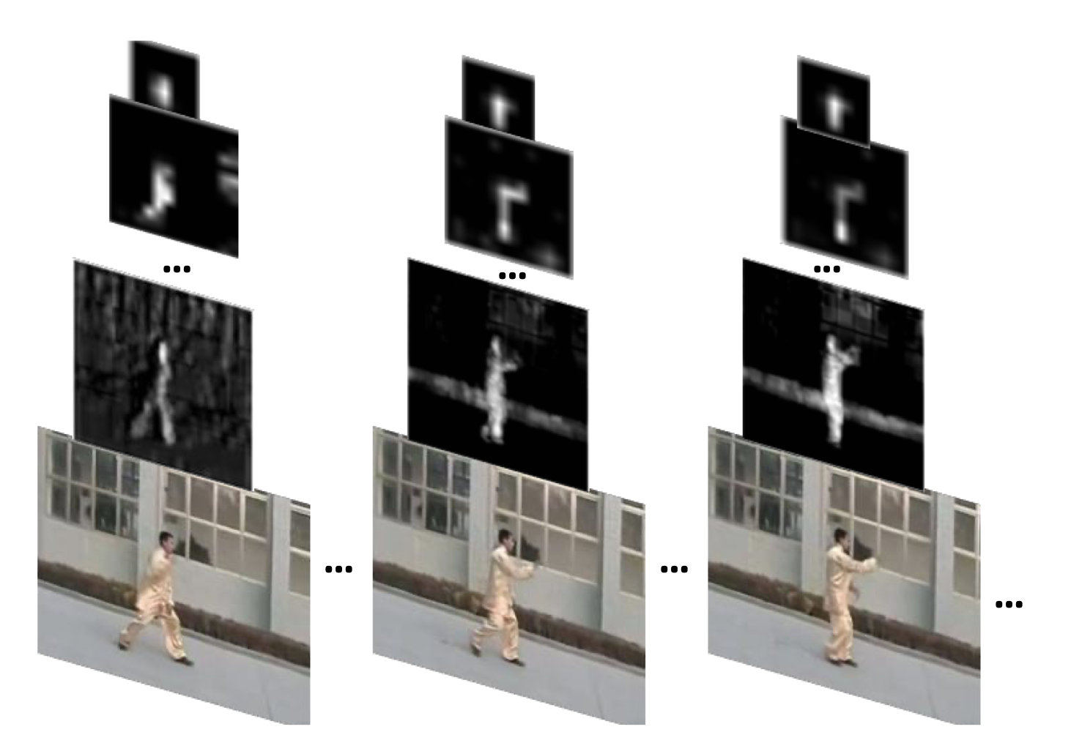
Seeing what can’t be seen
Convolutional LSTMs allow for the representation of temporal and temporal relationships concurrently
Explicit modeling of how band reflectance of trees change over time versus background crops, grass, shrubs, etc.
Technical problem:
Gradient explosion
Heavy gradient clipping

Slide 13
Combating variability
Focal loss – weight difficult false negatives higher
Lovasz softmax
Equibatch
Stratified sampling
Layer norm, batch re-norm
L2 loss
Zoneout
Data augmentation

Slide 14
Combating variability
Focal loss
Lovasz softmax - explicitly optimize IoU
Equibatch
Stratified sampling
Layer norm, batch re-norm
L2 loss
Zoneout
Data augmentation

Slide 15
Combating variability
Focal loss
Lovasz softmax
Equibatch
Stratified sampling
Layer norm, batch re-norm
L2 loss
Zoneout
Data augmentation

Slide 16
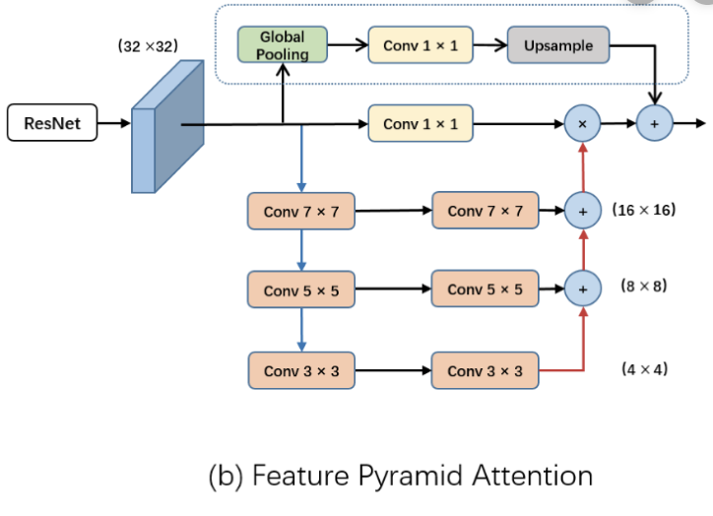
Pixel-level accuracy
Image segmentation is widely known to create fuzzy feature maps. Single pixel accuracy is still a topic of active research in computer vision. This research incorporates the best of the latest research on pixel-level accuracy, including:
Feature pyramid attention
Adabound optimizer
Hypercolumn decoder
Concurrent spatial and channel squeeze

Slide 17
Metrics
Prediction speed: 288,000 ha/hour/core
Model parameter size: 136,000 (vs. 60M+ in out-of-box algorithms): 500x speedup

Slide 18
Trees inside forest (>50% tree cover / hectare ): 90% recall, 88% precision
Scattered forest (20-50% tree cover / hectare): __ , __
Trees outside forest (<20% tree cover/ hectare): 63% recall, 58% precision

Slide 19
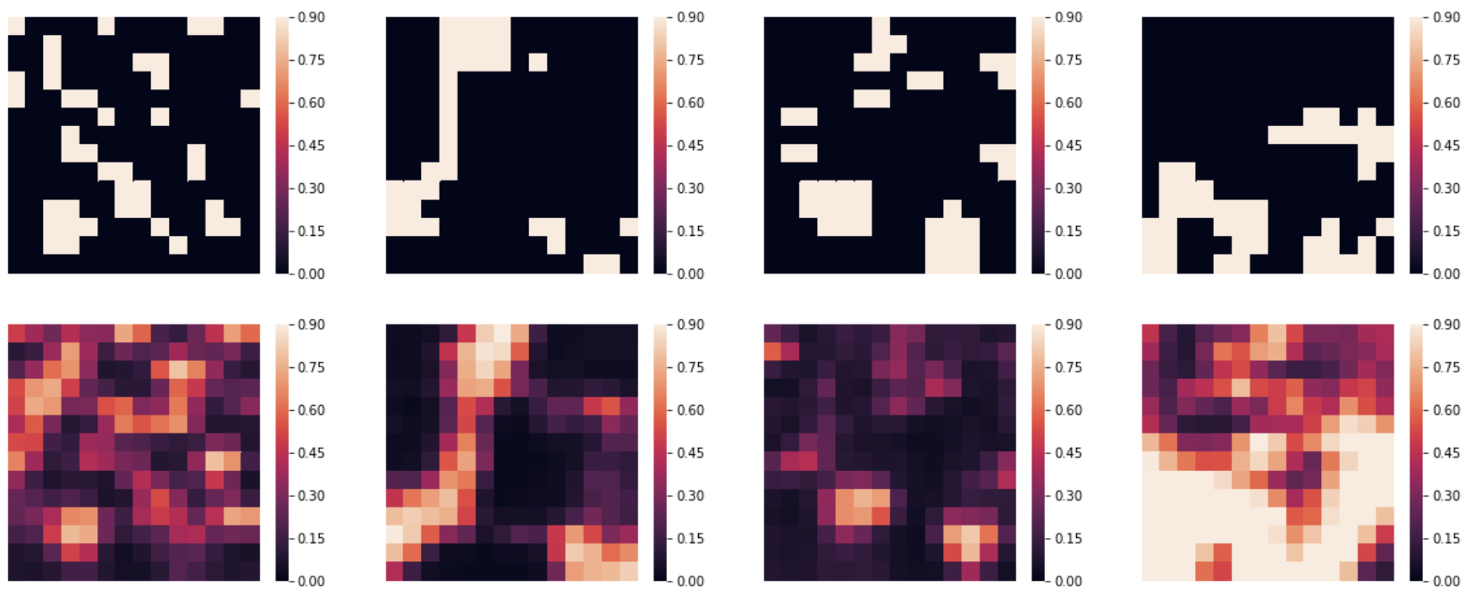

Slide 20
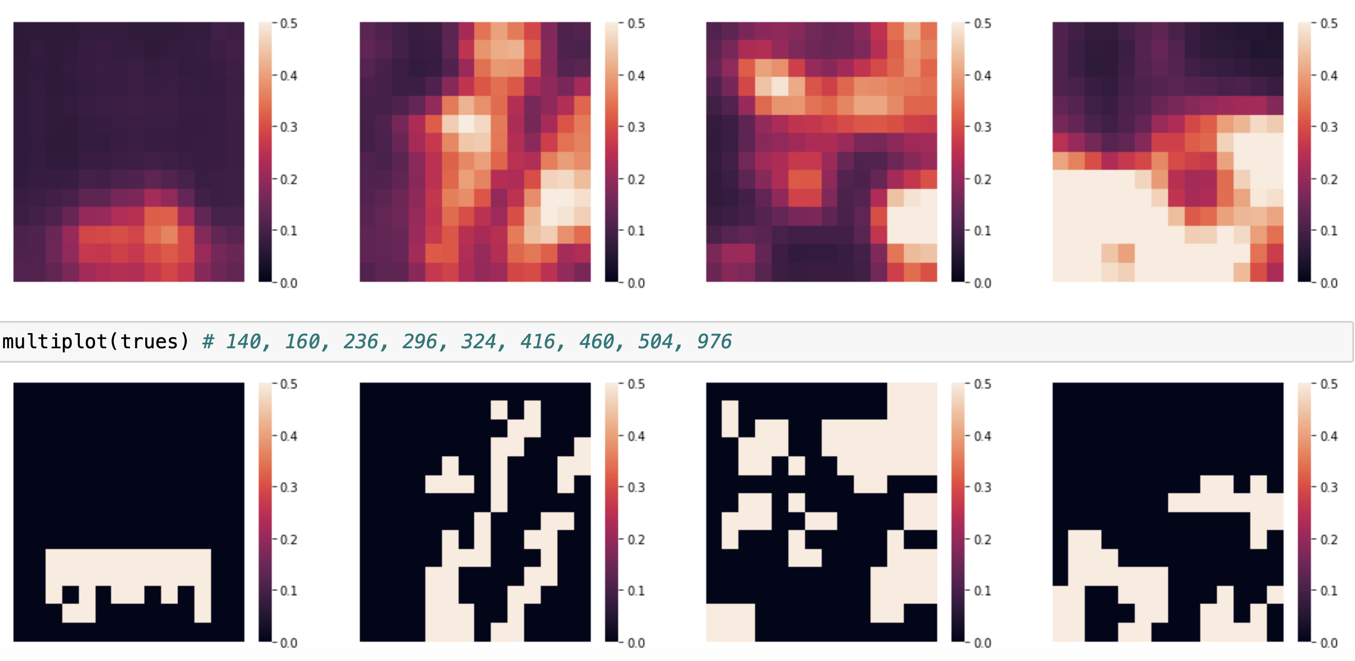

Slide 21
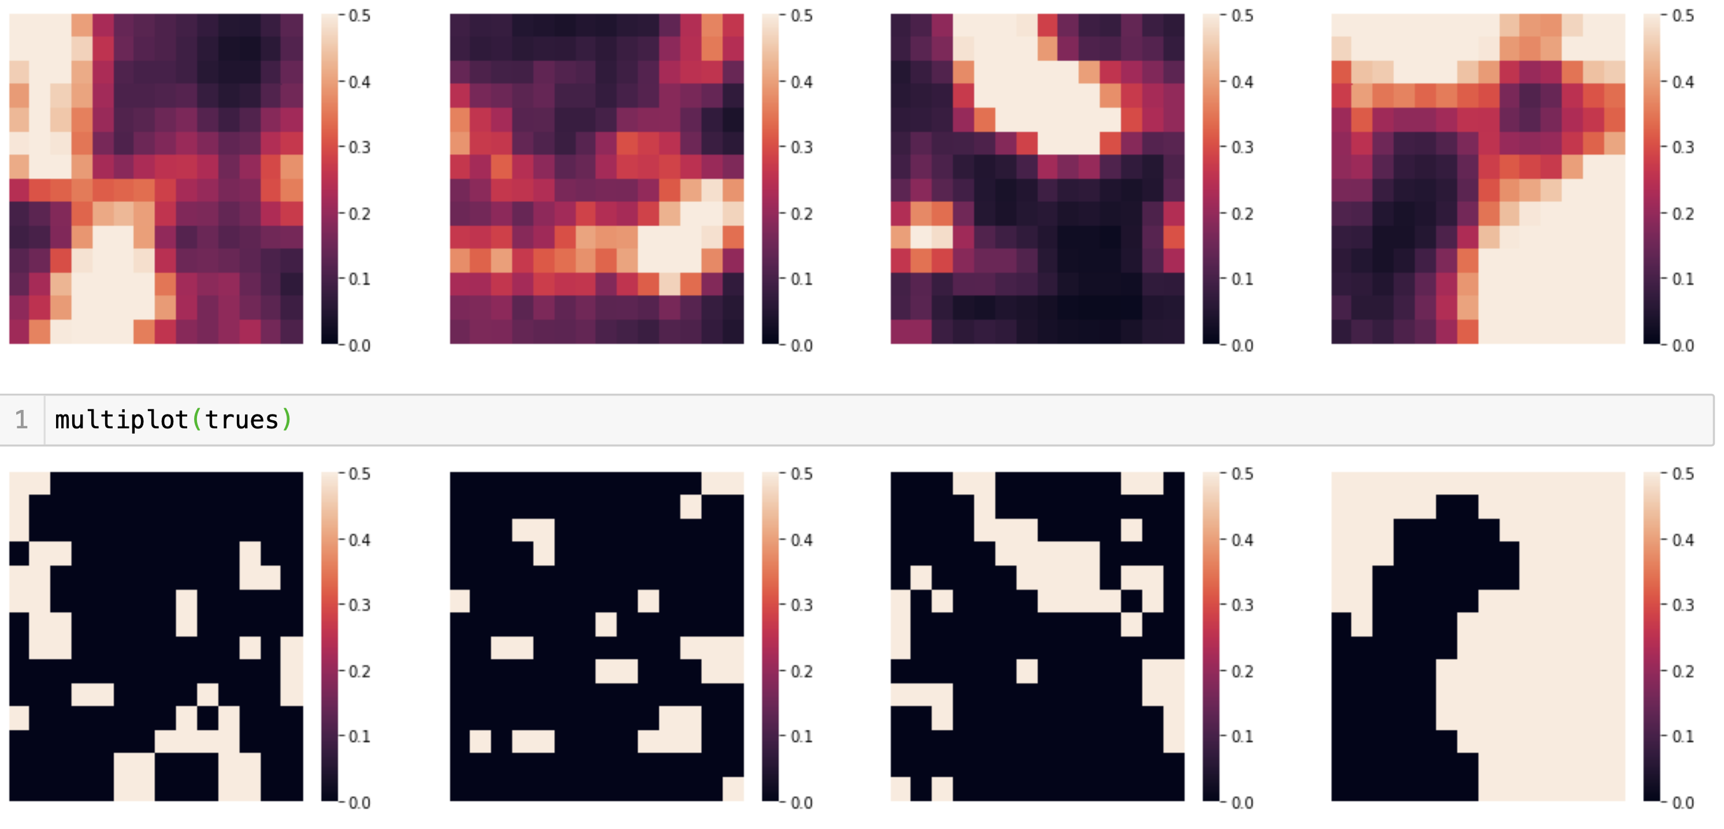

Slide 22
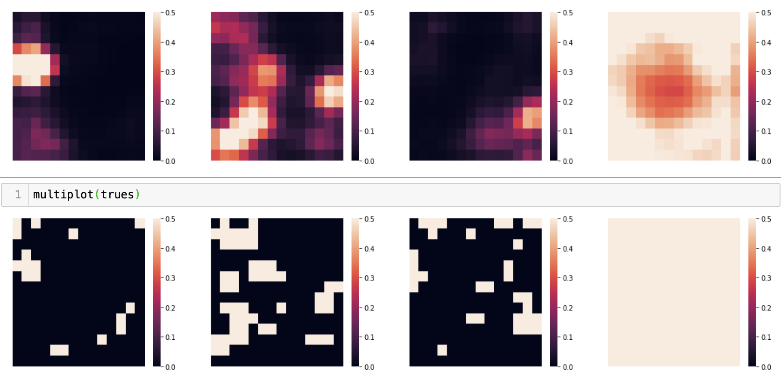

Slide 23
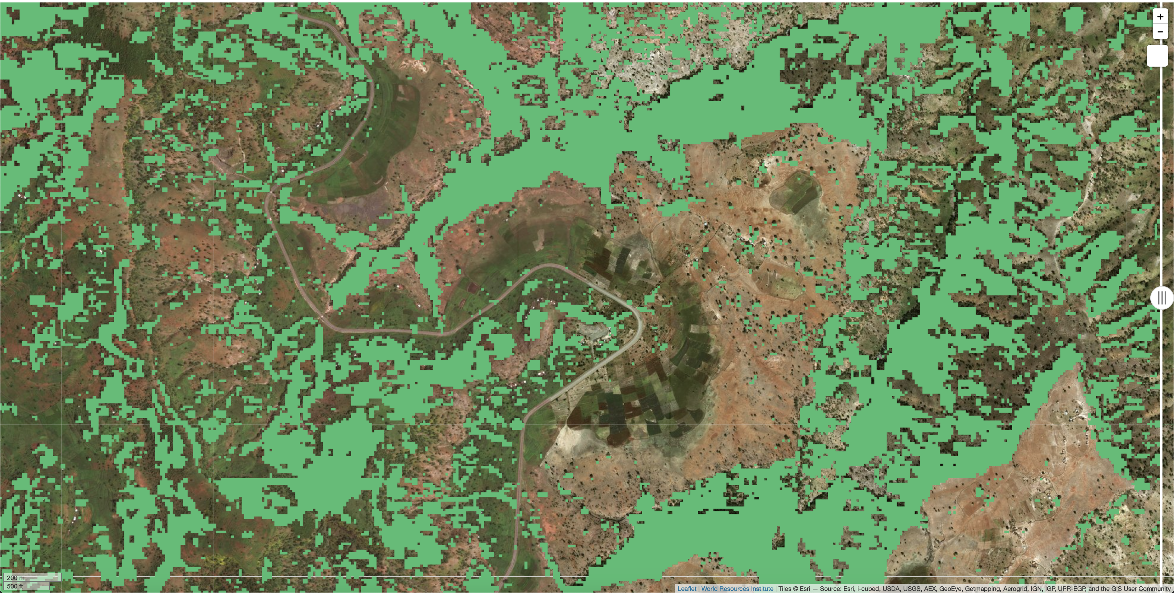

Slide 24
Future research
S1 S2 fusion
Atruous convolutions
Augmentations: shift, small rotations, mirroring, temporal
Hyperparameter search
Regularization search
Self training
Stratified K-fold training and averaged ensemble predictions
Temporal squeeze and excitation

